Slide 1

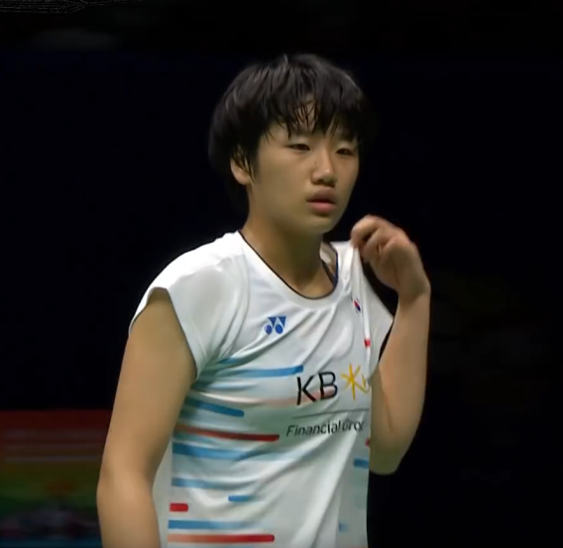


Rising Player
Women’s Singles
Women’s Singles
AN Se Young
9
Current Rank
At 17 March 2020
1335
Initial Rank
At 15 February 2018
69%
Win Rate
during BWF World Tour Era
Last Top Achievements
Winner Korea Masters 2019
Winner French Open 2019
Winner New Zealand Open 2019
Calculations based only on matches from BWF World Tour ≥ S300 Level, starting from 2018 to All England 2020
Match Sources: bwfbadminton.com
BWF TV

Slide 2

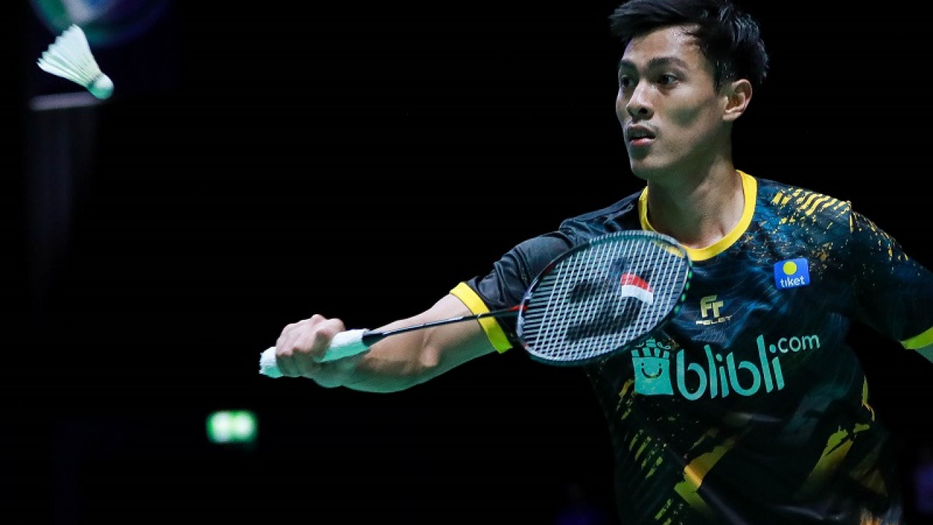

Rising Player
Men’s Singles
Shesar Hiren RHUSTAVITO
18
Current Rank
At 17 March 2020
52%
Win Rate
during BWF World Tour Era
Last Top Achievements
94
Initial Rank
At 4 January 2018
Semi finalist Chinese Taipei Open 2019
Image: Bola.com
Calculations based only on matches from BWF World Tour ≥ S300 Level, starting from 2018 to All England 2020
Match Sources: bwfbadminton.com
breakingnews.co.id

Slide 3

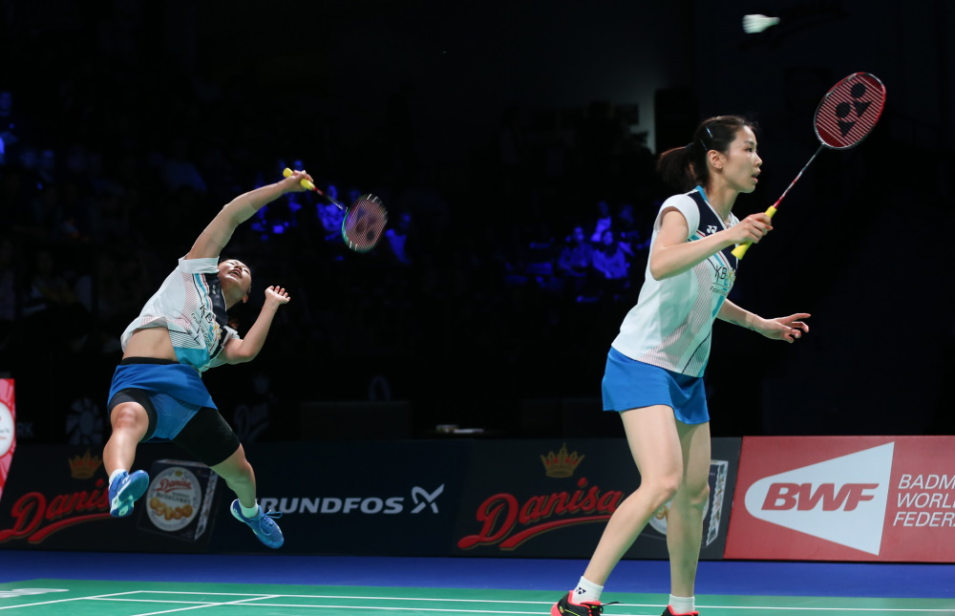

Rising Player
Women’s Doubles
BAEK Ha Na/JUNG Kyung Eun
10
Current Rank
At 17 March 2020
68%
Win Rate
during BWF World Tour Era
Last Top Achievements
241
Winner Syed Modi Championships 2019
Initial Rank
At 9 July 2019
Winner Denmark Open 2019
Calculations based only on matches from BWF World Tour ≥ S300 Level, starting from 2018 to All England 2020
Match Sources: bwfbadminton.com
BWF

Slide 4


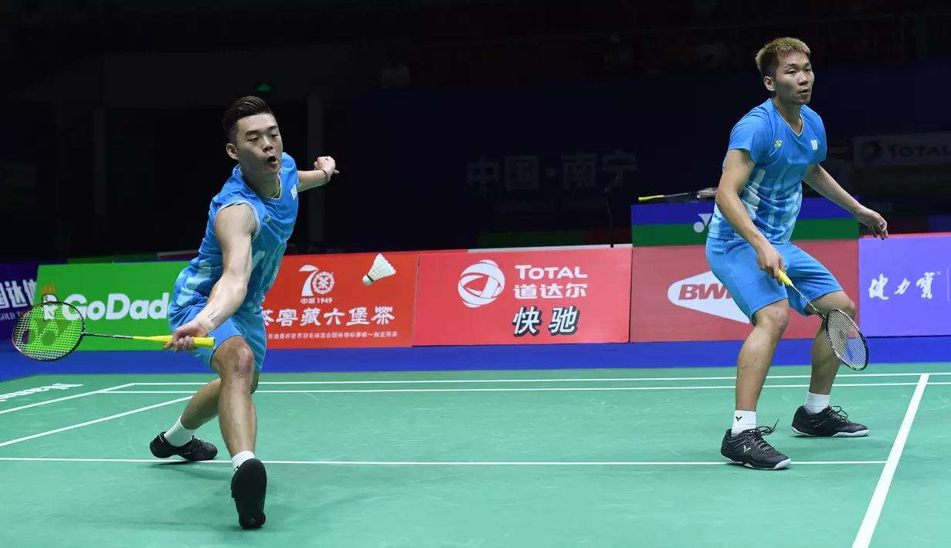


Rising Player
Men’s Doubles
LEE Yang/WANG Chi-Lin
7
Current Rank
At 17 March 2020
69%
Win Rate
during BWF World Tour Era
Last Top Achievements
161
Initial Rank
At 26 Feb 2019
Qualified to BWF World Tour 2019
Winner Korea Masters 2019
Winner India Open 2019
Winner Barcelona Spain Masters 2019
3 Last Top Achievements
Indonesia Masters 2020
China Open 2019
French Open 2019
Calculations based only on matches from BWF World Tour ≥ S300 Level, starting from 2018 to All England 2020
Match Sources: bwfbadminton.com
AFP Photo/Wang Zhao

Slide 5
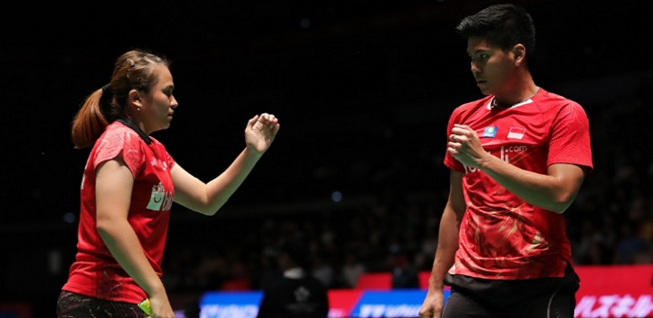

Rising Player
Mixed Doubles
Praveen JORDAN/Melati Daeva OKTAVIANTI
4
Current Rank
At 17 March 2020
66%
Win Rate
during BWF World Tour Era
Last Top Achievements
273
Initial Rank
At 25 Jan 2018
Winner All England 2020
Qualified to BWF World Tour 2019
Winner Denmark Open 2019
Winner French Open 2019
Calculations based only on matches from BWF World Tour ≥ S300 Level, starting from 2018 to All England 2020
Match Sources: bwfbadminton.com
BWF

